Slide 1

HACKOUT 2024
Team Name : Skill Issue
1)Maitra A. Amrutiya
2)Megh L. Kantariya
3)Aarykumar P. Dodiya
4)Aditya V. Patel

Slide 2
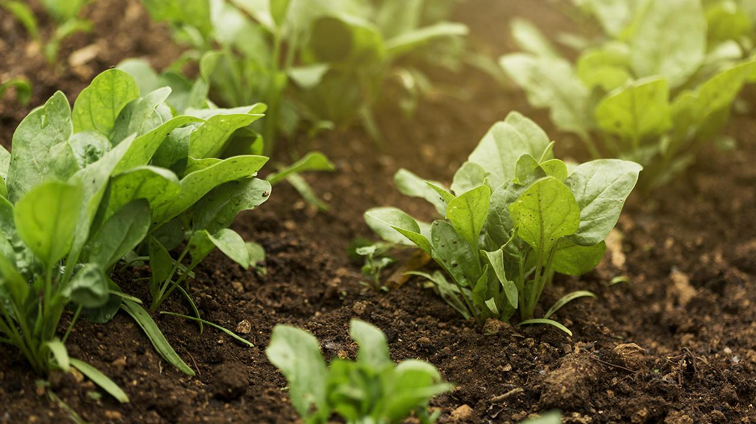
Climate Adaption in Agriculture

Slide 3
Contents of this template
1. Definition :
Climate change refers to significant, long-term changes in the average temperature, weather patterns, and other aspects of the Earth's climate system. It involves both natural processes and human activities.
2. Impact Of Climate Change On Agriculture :
Temperature Changes*: Rising temperatures can alter growing seasons, potentially leading to reduced crop yields. Extreme heat can also stress plants and reduce their productivity.
3. Importance Of Adaptation Strategies :
Adaptation helps reduce the impact of climate change on communities, infrastructure, and ecosystems. By preparing for and responding to climate-related changes, adaptation strategies can minimize damage and disruption.

Slide 4
Impact Of Climate Change On Crop Yields
Problem:
Increased frequency and intensity of temperature extremes due to climate change threaten public health, agriculture, infrastructure, and ecosystems.
Key Issues:
Public Health Risks: Higher heat-related illnesses and deaths; cold snaps cause hypothermia and other cold-related issues.
2. Agricultural Impact: Extreme temperatures affect crop yields and livestock health.
3.Infrastructure Strain: Damage to roads, bridges, and energy systems from temperature extremes.
Solutions:
Public Health Measures: - Develop early warning systems. - Create cooling and heating centers. - Increase health education on temperature extremes.
Agricultural Adaptation: - Invest in climate-resilient crops. - Adopt adaptive farming practices.
Infrastructure Resilience: - Upgrade infrastructure to withstand temperature extremes. - Incorporate heat mitigation in urban planning

Slide 5
Uses Of Climate Modeling Tools
Define Objectives: - Identify goals (e.g., predicting climate changes, guiding policies). - Choose appropriate models (GCMs, RCMs, impact-specific models).
Data Collection and Preparation: - Gather and clean historical climate and socioeconomic data. - Integrate data for comprehensive modeling.
Run the Models: - Configure and calibrate models with relevant parameters. - Perform simulations and validate results with historical data.
Analyze and Interpret Results: - Evaluate and interpret model outputs. - Visualize data through maps and graphs for clear communication.
Apply and Integrate Findings: - Use results to inform policies and strategic planning. - Develop and implement mitigation and adaptation strategies.
Monitor and Update: - Compare predictions with actual observations. - Update models and methodologies based on new data.
Promote Collaboration and Knowledge Sharing: - Engage stakeholders and provide training. - Share findings to support informed decision-making.

Slide 6
Adjusting Farming Practice
Changing Planting Dates And Crops Rotation :
1.Consider Climate: Align planting with frost dates and temperature needs.
2.Check Soil Conditions: Ensure proper warmth and moisture for the crop.
3.Manage Pests: Adjust timing to avoid peak pest and disease periods.
4.Follow Crop Needs: Adhere to specific planting windows for each crop.
Crop Rotation:
Rotate Families: Avoid planting the same crop family in the same spot to reduce pests and diseases.
Manage Nutrients: Use different crops to prevent nutrient depletion; legumes can enrich soil.
Enhance Soil Health: Use deep-rooted and cover crops to improve soil structure.
Plan Rotations: Follow a 3-4 year rotation cycle and consider companion planting for added benefits.

Slide 7
Planning With Climate Models
Overview Of Climate Modeling Tools :
Climate modeling tools simulate and predict climate changes by using historical data, greenhouse gas emissions, and physical principles. Global Climate Models (GCMs) simulate large-scale climate systems, while Regional Climate Models (RCMs) provide detailed local projections. Statistical and empirical models use historical data to forecast trends, and impact models assess climate effects on sectors like agriculture. These tools help in policy development, risk assessment, and resource management. Key features include resolution, data inputs and outputs, and integration with other tools. They are supported by institutions like IPCC and NOAA and accessed through platforms like CDO and ESGF.

Slide 8
Examples of Model Outputs and Their Agricultural Applications
1.Temperature Projections: Helps adjust planting dates and select heat-tolerant crops.
2.Precipitation Projections: Assists in designing irrigation systems and managing water resources.
3.Soil Moisture Predictions : Optimizes irrigation practices and prevents waterlogging.
4.Crop Yield Forecasts: Informs crop rotation, fertilization, and pest management strategies.
5.Growing Season Length: Guides adjustments in planting and harvest dates.

Slide 9
Addressing Potential Issue
Cost and Accessibility of New Technologies:
Cost Factors: - High Initial Costs: Significant upfront expenses. Operational Costs: Ongoing maintenance and training. Customization: Extra costs for tailored solutions.
Accessibility Factors: - Geographic Limitations: Limited access in remote areas. - Training Needs: Costs and availability of training and support. Economic Barriers: High costs may limit adoption for smaller users.
Improvement Strategies: - Financial Assistance: Subsidies and grants. Collaborative Approaches: Shared resources and partnerships.
Open Source Solutions: Free or low-cost technologies.

Slide 10
Need for Continuous Research and Development (R&D):
Innovation and Improvement: Drives technological advancements and adapts to evolving needs.
Competitive Advantage: Helps maintain market leadership and create unique products.
Problem Solving: Addresses emerging issues and complex challenges.
Economic Growth: Generates jobs and attracts investment.
Sustainability: Develops sustainable technologies and prepares for future needs . Ongoing R&D is crucial for fostering innovation, solving problems, and ensuring long-term economic and environmental sustainability.

Slide 11
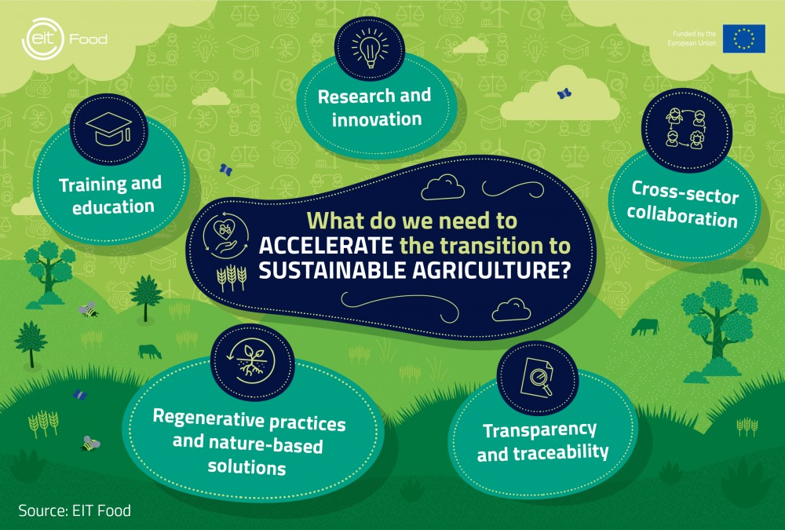
Conclusion
This powerpoint presents the overview of the website which would help the new generation farmers in crop recommendation and climatial changes which would affect their crops.

Slide 12
Jay Jawan Jay Kishan

